Slide 1
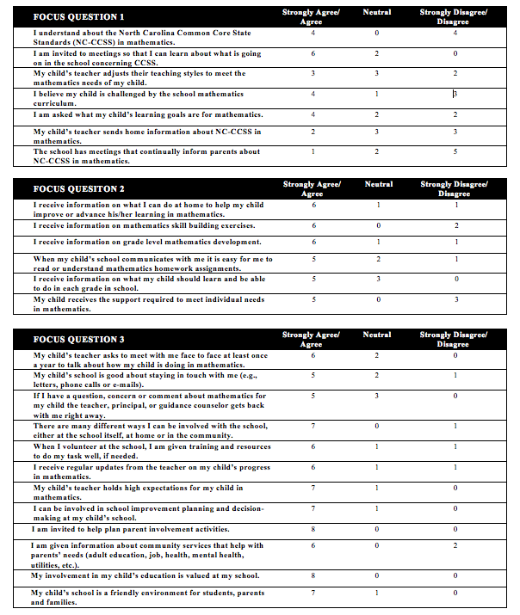
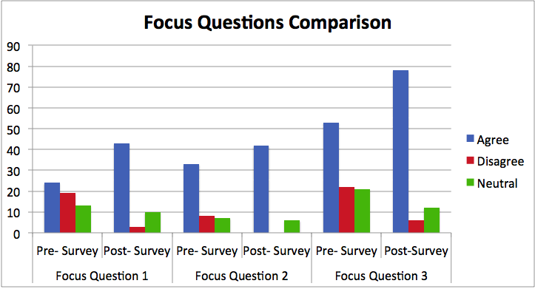
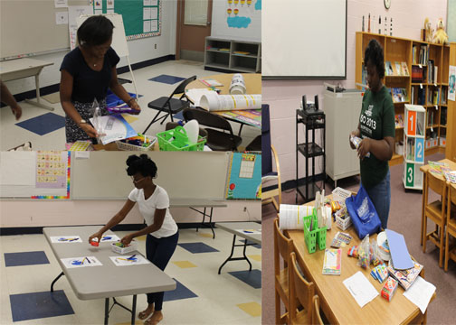
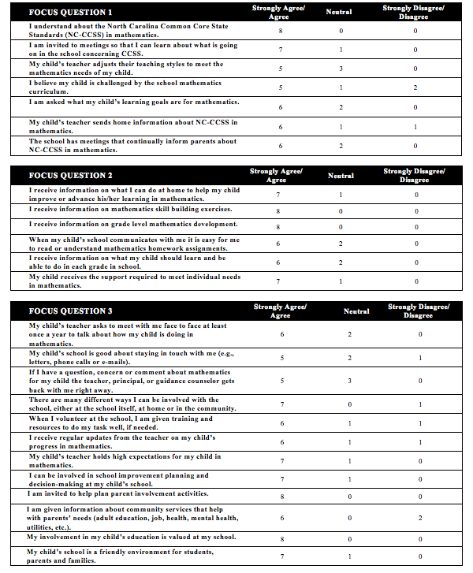
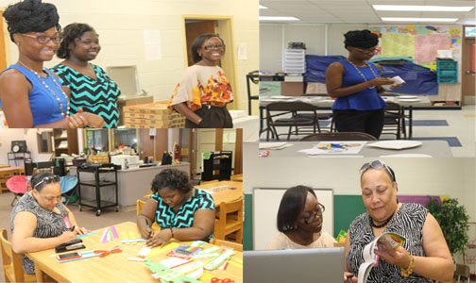
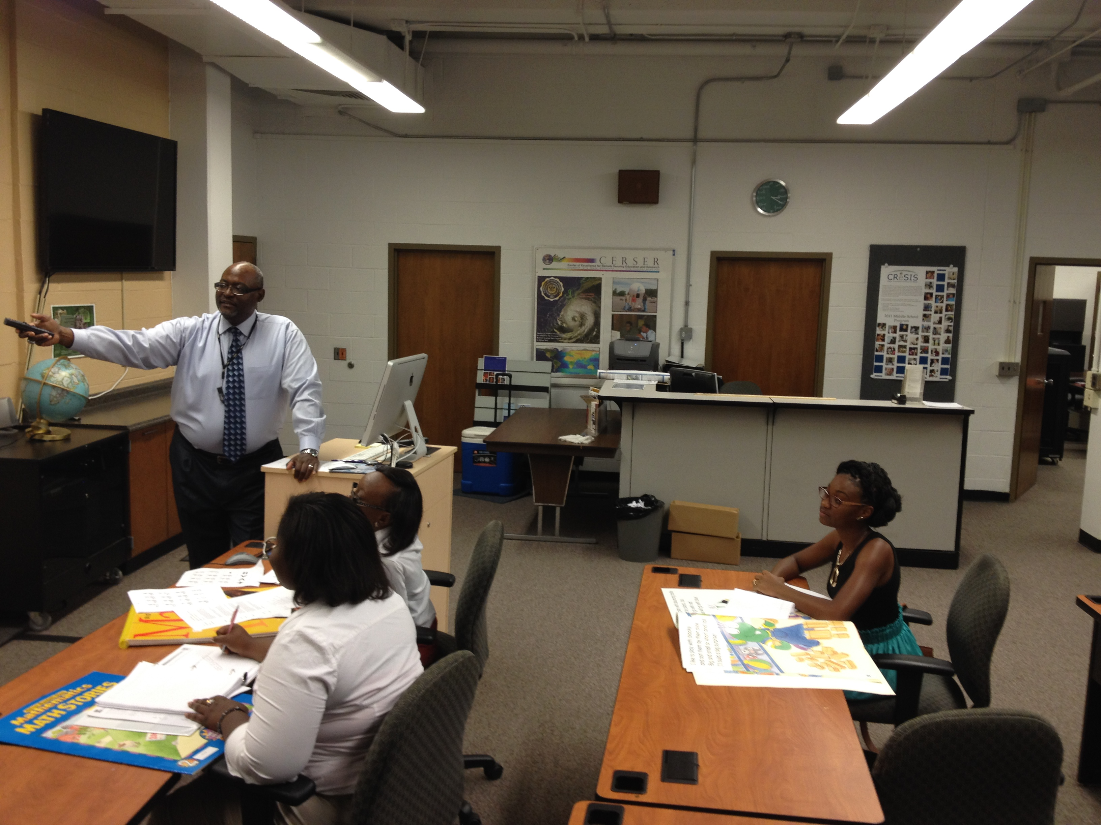
Enhancing Parent Involvement in NC-CCSS for K – 2 Mathematics
Team Members: Tayla Frizell (MVSU), Nyjah Grant (Longwood), Deanna Mallard (MVSU) Mentors: Dr. Darnell Johnson (ECSU), Dr. Ervin Howard (ECSU) Principal Investigator: Dr. Linda B. Hayden (ECSU), 1704 Weeksville Rd, Box 672, Elizabeth City, North Carolina 27909
ABSTRACT
Key Terms: Parent involvement, Common Core State Standards, Homework, K – 2 Mathematics
In this study, the 2014 REU math team developed and provided a workshop that assisted parents in understanding the North Carolina Common Core State Standards for K-2 Mathematics to assist with student homework assignments. Parent involvement is defined as parent participating in the educational processes and experiences of their children. A chi-square analysis was used to analyze data collected from the pre survey and the post survey administered to participants in the workshop. The study revealed all of the individual components of parent involvement were positively and significantly related to educational goals. The study identified various aspects of parent involvement that yielded statistically significant results in affirming that parent involvement attributed to urban student achievement. These findings were particularly helpful for indicating which kinds of parent involvement influenced academic success. Most notably, parent expectations and styles demonstrated a strong relationship with scholastic outcomes. Parent expectations and styles created an educationally oriented ambience that established an understanding of the certain level of support the child needed to succeed academically. The REU mathematics team focused on three essential questions in this study: (1) What practices will increase parent awareness of K-2 NC-CCSS for mathematics at P. W. Moore Elementary School? (2) What methods can be used to strengthen parent skills in assisting with mathematics homework assignments at P. W. Moore Elementary School? (3) What actions can be taken to motivate parent involvement in the school improvement process focusing on mathematics at P. W. Moore Elementary School?
PURPOSE
The purpose of this research was to develop training sessions in mathematics support skills for parents and/or guardians of Kindergarten through 2nd grade students enrolled at P. W. Moore Elementary School. Parents’ attitudes toward mathematics have an impact on children's’ attitudes. This process will extend mathematical concepts from the classroom to home and establish the idea that mathematics is not just a school subject, but an everyday subject.
CHI-SQUARE TEST
The Chi-Square Test showed a comparison of the observed values (parent’s survey response) and the expected values( parent’s strong agreement), which are listed above and concluded that the impact of the Parent Involvement Workshop was considered to be a positive factor in influencing parent’s attitudes of the research focus questions. In the analysis of the pre and post surveys, the Chi-Square Test determined a statically significant relationship exists.
ACKNOWLEDGEMENTS
We, the 2014 Research Undergraduates Mathematics Team would like to give a special thanks to Dr. Linda B. Hayden, Dr. Darnell Johnson, Dr. Ervin Howard, Dr. Stephanie D. B. Johnson, Principal Lindsey James, Teacher of the Year Mrs. Joycelyn Hinton, the REU Staff, and staff of P.W. Moore Elementary School.
PARTICIPANTS
Participants for this study were selected using a voluntary response method. In detail, 150 flyers were mailed to P.W. Moore Elementary School parents of Kindergarten, 1st grade, and 2nd grade students. There was a low participant rate of 5% in comparison to the number of flyers sent out to parents. Of those who responded, these parents showed an interest in their involvement in their child’s education., from the eight parents 25% were male and 75% were female.
CONCLUSION
The results of the survey concluded that parent involvement contributes to growth in student learning. Good parents accomplish things, including motivating and engaging their children, acquiring new knowledge and skills, and collaborating with teachers. But those accomplishments best serve their purpose when they lead their child to help improve student achievement. Professional development leads effective parents to support their children in the mathematics lesson by assisting with homework assignments and keeping in contact with the child's teacher when need be upon measuring students’ growth in learning along the way. The workshop provided richer information on what skills and topics students are learning according to the Common Core State Standards. In this way, the standards provided the parents with a different perspective on mathematics and understand the importance of being involved with their child’s education. At the conclusion of the workshop, parents understood the math language by constructing different activities and were given different tips that can be used in the home.
Pre Survey Chi – Squared Test
0.70864 | 0.73272 | 0.88500 | 0.99093 | 0.82452
0.16702 | 0.80250 | 0.20019 | 0.94795 | 0.90287
0.36918 | 0.68435 | 0.91938 | 0.49389 | 0.23861
0.82452 | 0.58715 | 0.42888 | 0.82452 | 0.22520
0.10056 | 0.10733 | 0.05877 | 0.73272 | 0.51660
TABLE 2. CHI Square Test of an expected value of 5 and pre-survey responses as the observed.
Workshop of Summer 2014 K – 2 Parents
 | Kindergarten | 1st Grade | 2nd Grade
Male | 1 | 1 | 0
Female | 2 | 3 | 2
TABLE 1. K – 2 Parent Demographics
Post Survey Chi – Squared Test
0.99483 | 0.99974 | 0.99997 | 0.97864 | 0.84570
0.99899 | 0.97864 | 0.93444 | 0.97864 | 0.95984
0.68435 | 0.88500 | 0.95984 | 0.90287 | 0.51660
0.99093 | 0.99093 | 0.94795 | 0.99093 | 0.88500
0.99744 | 0.58715 | 0.95984 | 0.99974 | 0.99483
TABLE 3. CHI Square Test of an expected value of 5 and pre-survey responses as the observed.
METHODOLOGY
Pre and post surveys were used to gage workshop results pertaining to parent involvement. These surveys consisted of twenty-five questions which addressed the following: North Carolina Standards for Kindergarten through 2nd grade mathematics; parent’s skills/understanding of children’s mathematics homework; and parent’s participation in school related activities. In these questions, parents chose their level of agreement using 1 as strongly disagree, 2 as disagree, 3 as neutral, 4 as agree, and 5 as strongly agree. Once pre surveys were distributed parents would attend an educational workshop pertaining to their child’s grade level. At the conclusion of the workshop, parents completed post surveys to assess whether or not the information was conveyed correctly.
RESULTS
The results gathered from the pre-survey and post-survey instruments were used to determine whether or not the information conveyed during the workshop produced any changes parent’s attitudes toward Kindergarten through 2nd grade mathematics. Examining the Focus Question Comparison graph, there is a notable increase in agreement with the questions dealing with the third focus question. This question discussed parent’s motivation to become involved in the school environment. The workshop primarily focused on the ways in which parents can use themselves as a tool to make a better learning setting for their children.
FUTURE WORK
The long-term goal is to build stronger parent support system in Kindergarten, 1st grade and 2nd grade Mathematics in Pasquotank County Public Schools using the North Carolina Common core State Standards. Continuation of this parent involvement workshop will be conducted at P. W. Elementary School during the 2014 – 2015 academic school year. Using the same research methods, attendance will be enhanced by soliciting parents of Kindergarten through 2nd grade level teacher’s classrooms.
REFERENCES
Common Core State Standards Initiative. (2014). Mathematics Standards [Online]. Available: http://www.corestandards.org/Math/ (URL)
North Carolina Department of Public Instruction. (2014). NC Math Common Core – Elementary [Online]. Available: http://maccss.ncdpi.wikispaces.net/Elementary (URL)
For a full reference listing, please see REU Math Team webpage.

